Slide 1
LAN Connections
Understanding Cisco Router Security

Slide 2

Common Threats to Physical Installations
  Hardware threats
  Environmental threats
  Electrical threats
  Maintenance threats

Slide 3
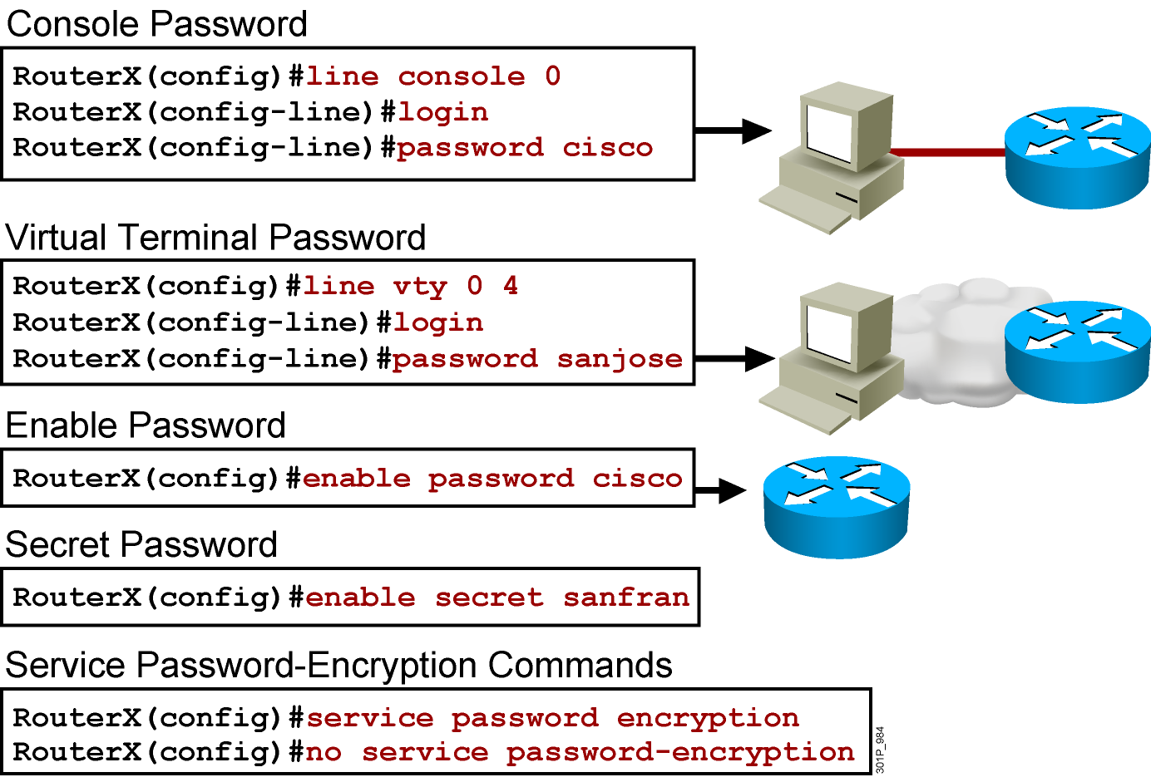
Configuring a Router Password
Notes:
Layer 2 of 2
Emphasize: The router has one enable password. Remember that this is your only protection. Whoever owns this password can do anything with the router, so be careful about communicating this password to others. To provide an additional layer of security, particularly for passwords that cross the network or are stored on a TFTP server, you can use either the enable password or enable secret commands. Both commands accomplish the same thing; that is, they allow you to establish an encrypted password that users must enter to access enable mode (the default), or any privilege level you specify. Cisco recommends that you use the enable secret command because it uses an improved encryption algorithm. Use the enable password command only if you boot an older image of the Cisco IOS software, or if you boot older boot ROMs that do not recognize the enable secret command. If you configure the enable secret password, it is used instead of the enable password, not in addition to it.
Cisco supports password encryption. Turn on password encryption using the service password-encryption command. Then enter the desired passwords for encryption. Immediately, on the next line, enter the no service password-encryption command. Only those passwords that are set between the two commands will be encrypted. If you enter service password-encryption and then press Ctrl-Z to exit, all passwords will be encrypted.
Note: Password recovery is not covered in the course materials. Refer the students to the IMCR class.

Slide 4

Configuring the Login Banner
  Defines and enables a customized banner to be displayed before the username and password login prompts
RouterX# banner login " Access for authorized users only. Please enter your
username and password. "

Slide 5
Telnet vs. SSH Access
  Telnet
    Most common access method
    Insecure
  SSH
    Encrypted
    IP domain must be defined
    key must be generated
!--- The username command create the username and password for the SSH session
username cisco password 0 cisco
ip domain-name mydomain.com
crypto key generate rsa
ip ssh version 2
line vty 0 4
login local
transport input ssh

Slide 6
Summary
  The first level of security is physical.
  Passwords can be used to restrict access.
  The login banner can be used to display a message before the user is prompted for a username.
  Telnet sends the session traffic in cleartext; SSH encrypts the traffic.

